Slide 1
Finite Automata and Formal Languages(18CS52)
DEPARTMENT OF CSE
R V College of Engineering

Slide 2
Regular Expressions and Automata Theory
Practice questions

Slide 3
Convert Regular expression to ε-NFA
(a*+b*+c*)ab
(a*b*+c)*

Slide 4
Minimize the following automata
States | 0 | 1
→A | B | E
B | C | F
*C | D | H
D | E | H
E | F | I
*F | G | B
G | H | B
H | I | C
*I | A | E

Slide 5
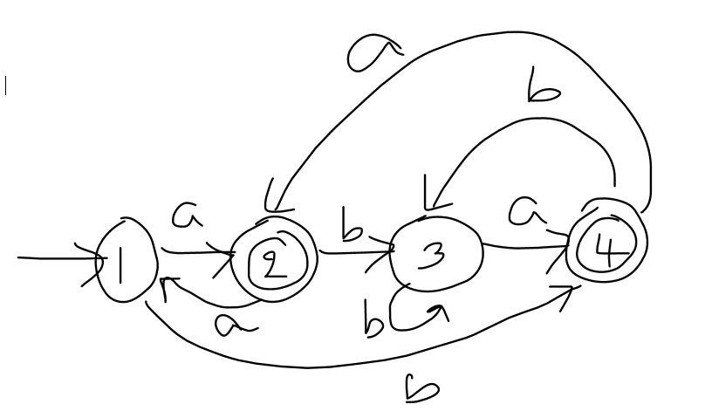
Convert DFA to RE

Slide 6
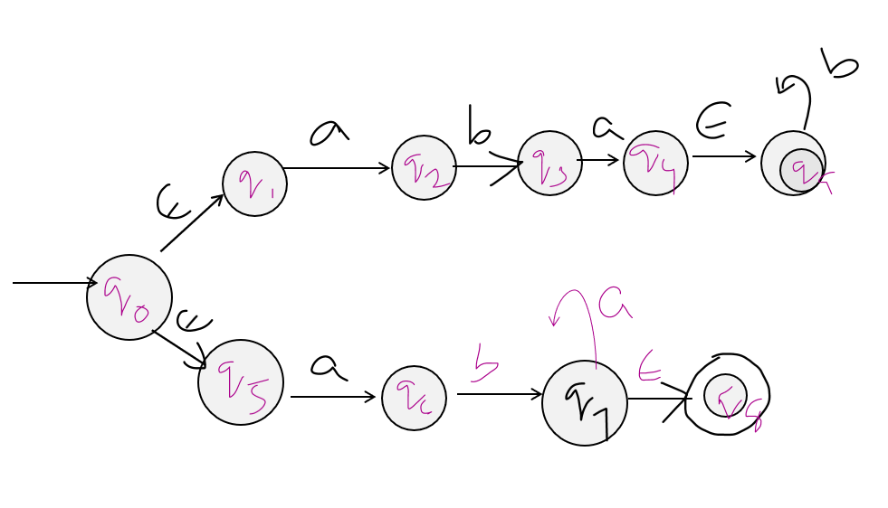
Convert ε-NFA to DFA

Slide 7
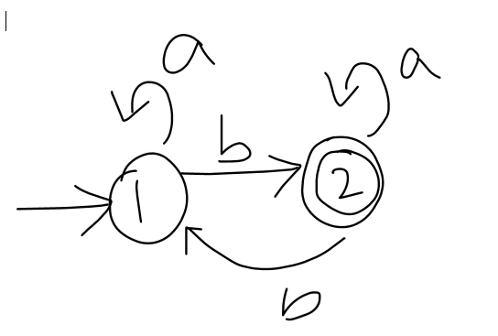








Convert DFA to RE(kleen’s)
a*b(a*+ba*b)*a*

